Slide 1
AsciiDoc
A Hands-On Approach

Slide 2
Overview
AsciiDoc is a text document format for writing notes, documentation, articles, books, ebooks, slideshows, web pages, man pages and blogs. AsciiDoc files can be translated to many formats including HTML, PDF, EPUB, man page.
http://asciidoc.org/

Slide 3
Applications to Use
AsciiDoc – distributed with many Linux Distros
http://asciidoc.org/INSTALL.html
Atom Editor (WYSIWYG) open source, multi-platform editor
https://atom.io/
AsciiDoctor – Installed with Ruby

Slide 4
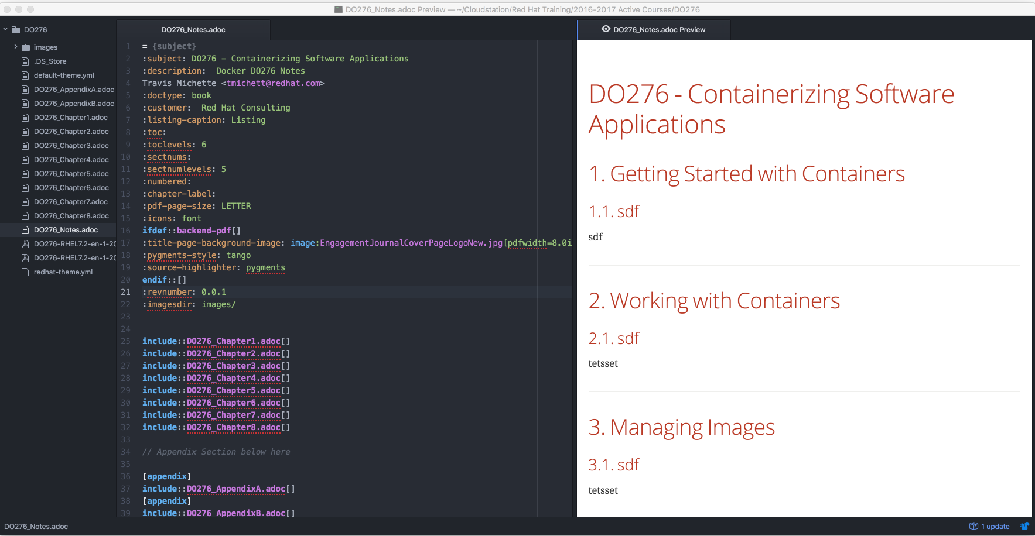
Atom Editor

Slide 5
Atom Editor cont.
Contains multiple plugins
Allows live HTML previews
Can manage multiple files and create projects
Available across platforms (Linux, Mac, Windows)

Slide 6
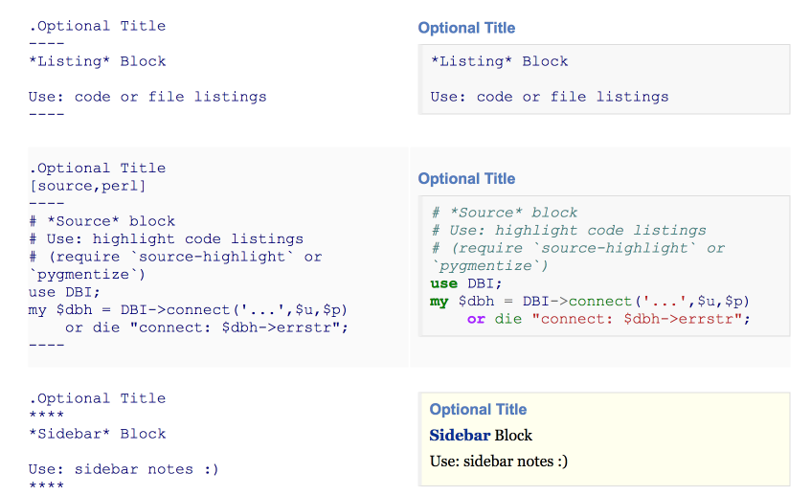
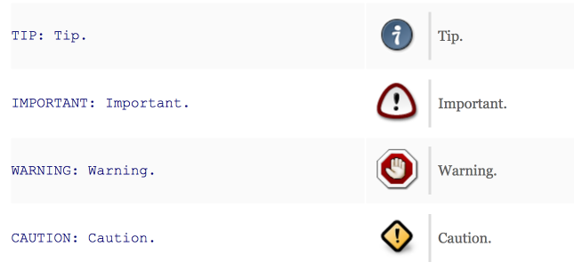
AsciiDoc Formatting
AsciiDoc is a text-only process and will process directives and the markup language to create desired effects and outcome.
http://powerman.name/doc/asciidoc

Slide 7
AsciiDoc Themes
footer:
font_size: $base_font_size_small
font_color: $base_font_color
font_family: Liberation Sans
font_style: bold # NOTE if background_color is set, background and border will span width of page
border_width: 0.5
border_color: ff0000
# additional attributes for content:
# * {page-count}
# * {page-number}
# * {document-title}
# * {document-subtitle}
# * {chapter-title}
# * {section-title}
# * {section-or-chapter-title}
AsciiDoc themes allow creation and usage of templates to create PDF and other documents that are produced in a uniform output to ensure all documentation looks the same. A template is generally a YAML (.yml) file.
AsciiDoctor to Process PDF
# asciidoctor-pdf RH403_RPM.adoc -a pdf-stylesdir=./

Slide 8
AsciiDoctor and AsciiDoctor-PDF
AsciiDoctor can be installed with Ruby to process AsciiDoc documents. AsciiDoctor is very close in terms of AsciiDoc and can at times be easier to generate PDFs and other publications.
Installing AsciiDoctor
# yum install ruby
# gem install asciidoctor
# gem install --pre asciidoctor-pdf
# gem install coderay pygments.rb
http://asciidoctor.org/
Verifying AsciiDoctor-PDF
# asciidoctor-pdf -v
AsciiDoctor to Process PDF
http://asciidoctor.org/docs/convert-asciidoc-to-pdf/#install-the-published-gem
# asciidoctor-pdf RH403_RPM.adoc -a pdf-stylesdir=./

Slide 9
Hands-On Practice
Installing AsciiDoc
Installing Atom Editor
Examining themes/templates
Creating a PDF

